Slide 1

Visual Storytelling
Subtitle goes here

Slide 2
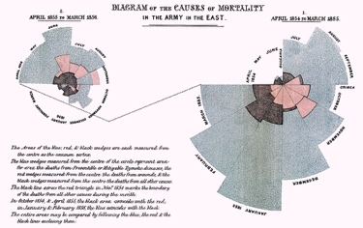
Notes:
https://commons.wikimedia.org/wiki/File:Nightingale-mortality.jpg

Slide 3
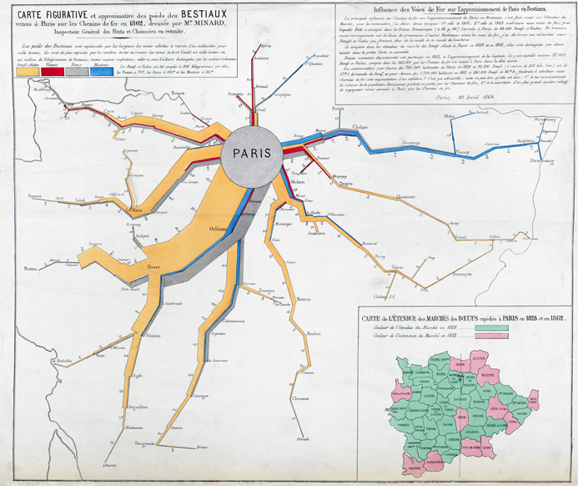
Notes:
Cite from another source but found: https://sandrarendgen.wordpress.com/2013/06/22/the-forgotten-maps-of-minard/
Here is an example from 1864 of how Minard used the graphical representation of the circulation of goods as a tool of investigating economical and infrastructural questions. The map shows how much meat was exported by railway from various regions of France to accommodate the capital Paris during the year 1862

Slide 4
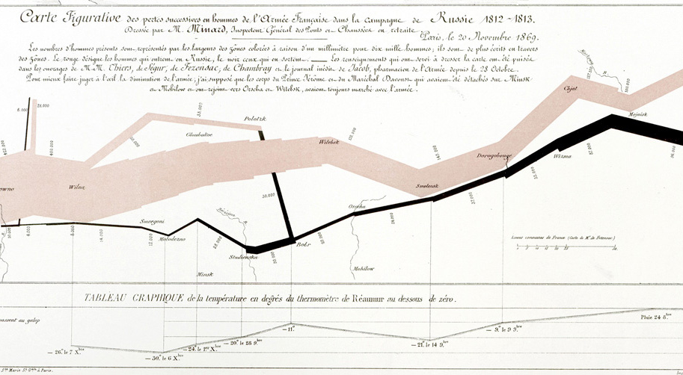
Notes:
Minard’s that Tufte brought to even greater attention. Whether you believe this is the best graphic to show, it does a lot well,

Slide 5
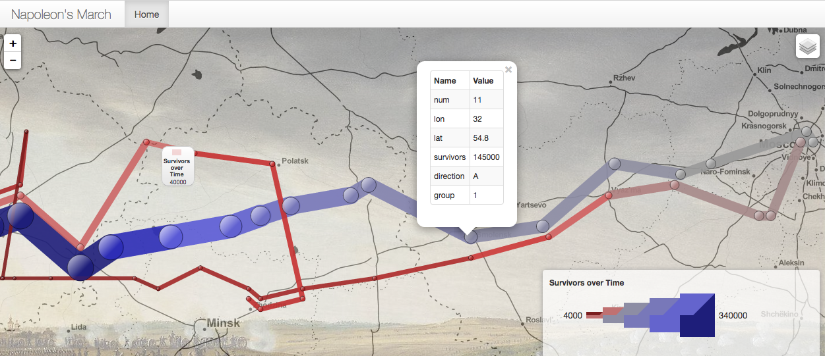
http://humangeo.github.io/leaflet-dvf/examples/html/minard.html#
Notes:
Here we have an interactive version that actually doesn’t do as good a job of highlighting. Technology and having greater amount of ways of updating, showing, and interacting with data.

Slide 6
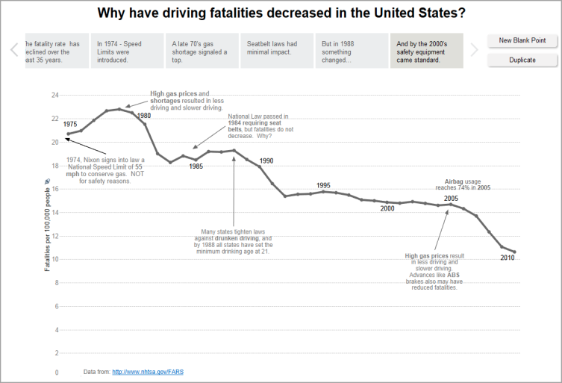
https://onlinehelp.tableau.com/current/pro/desktop/en-us/stories.html

Slide 7
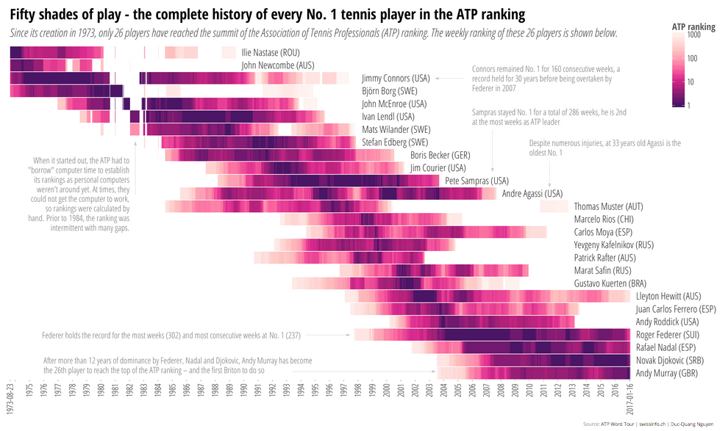
http://www.swissinfo.ch/eng/who-is-the-best-_the-complete-history-of-every-no--1-tennis-player/42274984
Notes:
Unpack

Slide 8
[Placeholder for example image]

Slide 9
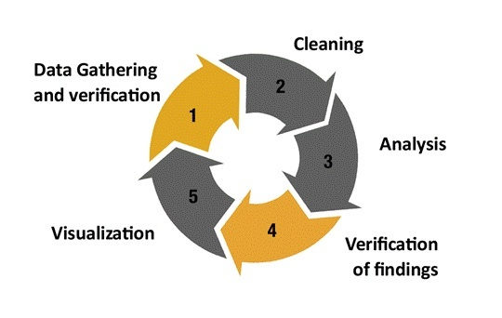
http://projects.nyujournalism.org/newsliteracy2016/topics/data/

Slide 10
“It’s more common NOT to publish than to publish.”
Sarah Cohen, editor of New York Times computer-assisted reporting team

Slide 11
Tools for analysis
=
Tools for presentation
Notes:
“Visualization researchers often tacitly assume that the tools used for analysis are usable for presentation just as well as for their original purpose. We believe that to be a very limiting assumption.” Robert Kosera and Jock Mackinlay of Tableau research.
http://dataplusscience.com/files/Kosara_Computer_2013.pdf

Slide 12
Tools for analysis
=>
Tools for presentation
Notes:
http://dataplusscience.com/files/Kosara_Computer_2013.pdf

Slide 13
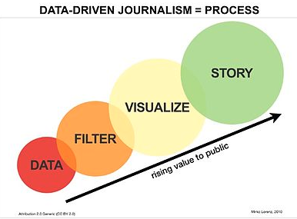
[Placeholder for Custom Graphic]
Notes:
CUSTOM IMAGE unfurl the previous image into a data story that brings up when it is presented. Think back to visualization supporting insights/ tasks – insights for who and when? Have the insights for you as the data scientist and analyst and then communicating those to a broader audience.

Slide 14
Histogram: https://learn.devfe.st/datascience/third.png
Austin Temp. Chart: https://blog.modeanalytics.com/images/post-images/viz-libraries-04.png
Notes:
Examples overlayed on graphic of how visualization you create for analysis are different than presentation.

Slide 15
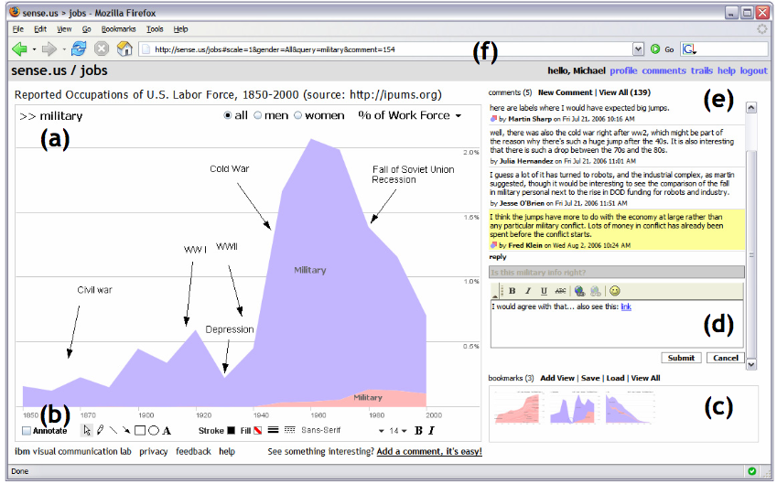
Collaborative Analysis/ Stories
http://hint.fm/papers/2007-sense.us-CHI.pdf
Notes:
With some notable possible exceptions such as a social tool where the exploration and presentation are co-occuring, but even then you can bet that there were visualizations for analysis before making choices around the social presentation.

Slide 16
Communicate
a Process
Notes:
Several genres. These include.

Slide 17
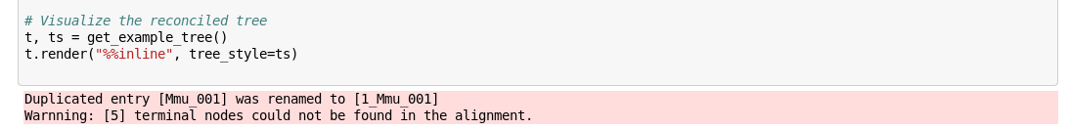
Processes are messy!
Code Image Source: http://etetoolkit.org/static/img/notebook.alg.png
Notes:
In the process of analysis there are bumps along the way as we’ve learned.

Slide 18
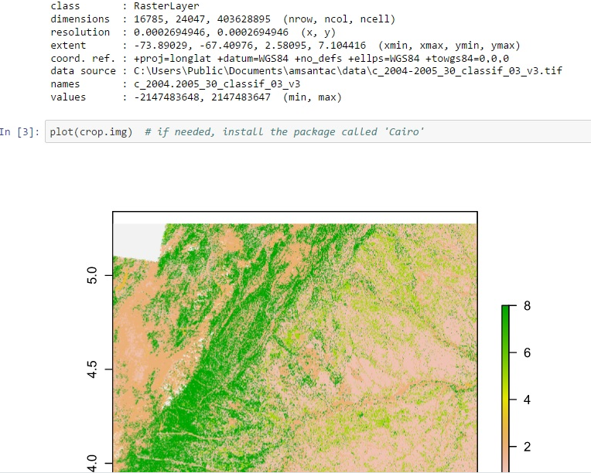
Reproducibility
Image Source: http://amsantac.co/images/2016-06-29-reproducibility-arcpy-jupyter-notebook-r-fig-8.jpg
Notes:
http://amsantac.co/images/2016-06-29-reproducibility-arcpy-jupyter-notebook-r-fig-8.jpg

Slide 19
Communicate
the Findings
Notes:
Several genres. These include.

Slide 20
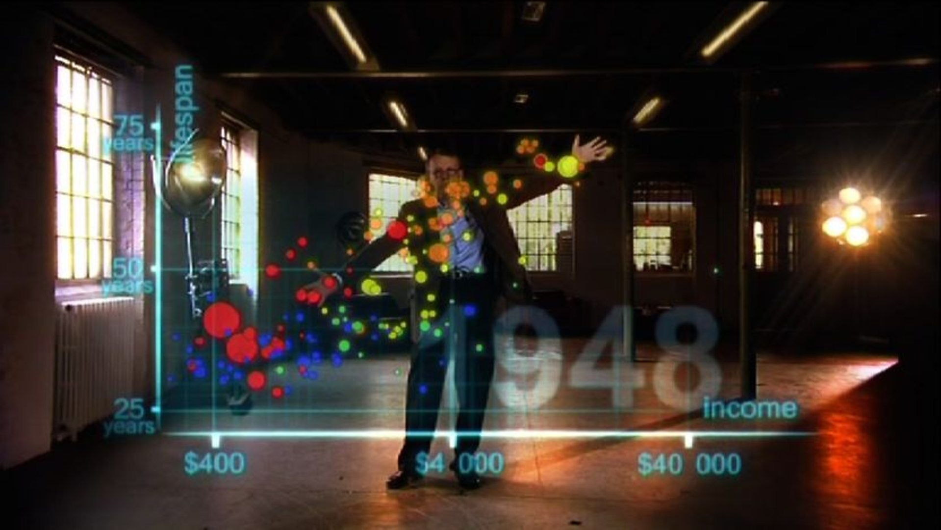
https://ichef.bbci.co.uk/images/ic/1920x1080/p02c35nh.jpg

Slide 21
Who / what is presenting?
Who is the audience?
What are the affordances for the presentation?
How might the story get passed along?

Slide 22

Changing stories
Image Source: http://www.ancient-origins.net/myths-legends/
Notes:
If self directed.
http://www.ancient-origins.net/myths-legends/story-ragnarok-and-apocalypse-001352

Slide 23
Data Provenance
Citing and or/ linking:
data sources
methodological choices & relevant facts
Annotating exceptions & corrections
[Hullman & Diakopoulos, 2011]
Notes:
http://faculty.washington.edu/jhullman/vis_rhetoric.pdf
Visualization Rhetoric: Framing Effects in Narrative Visualization

Slide 24
Representing Uncertainty
Visually (e.g., error bars),
OR textually by describing:
inferential limits
forecast annotations
extrapolated data points (labels)
doubt regarding possible conclusions
[Hullman & Diakopoulos, 2011]

Slide 25
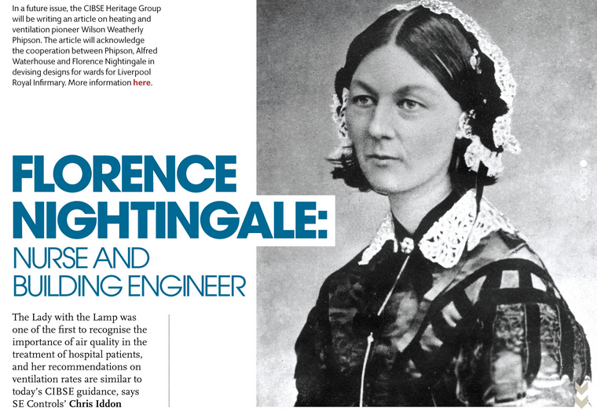
The Storyteller
We all have bias!
Image Source http://portfolio.cpl.co.uk/CIBSE/201505/profile-florence-nightingale/
Notes:
Bios for authorship can provide further info about the designer and give context for possible bias that might have arisen.

Slide 26


